Slide 1
R Shiny for Operations and GIS
Instructor: Geoffrey Arnold

Slide 2
About the Instructor
Education:
University of Pittsburgh: BA Political Science & History 2010
Heinz College: MS PPM 2015
Professional:
PA State Democratic Party: Field Organizer 2010
City Year Greater Philadelphia: Senior Corps Leader: 2011-2012
Lutheran Child & Family Services: Group Leader 2013
City of Pittsburgh: Performance Improvement Analyst 2015-2017

Slide 3
Schedule
GitHub bare bones
Basic Concepts of Shiny Apps
Shiny Dashboards
Widgets & Reactivity
Update Inputs & More
Shiny & Rmarkdown
shinyapps.io

Slide 4
GitHub What to do:
All course materials are available through GitHub: https://github.com/RforOperations2018/
Download GitHub for Desktop: https://desktop.github.com/
Create an account: https://github.com/join
Follow the Course repository (repo)
All of your projects should have their own GitHub repo.
This is so I can see what you tried, and also determine who did one on any group work.

Slide 5
How to use Github
Select lines to “commit” to your code, add comments and title each commit.
Let’s you go back to old code

Slide 6
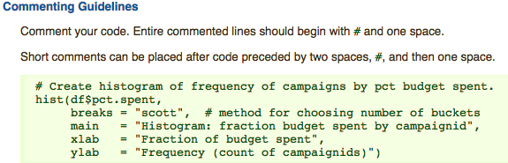
R Style Guide
We will be using the Google R Style Guide for this course: https://google.github.io/styleguide/Rguide.xml#comments

Slide 7
Basic Concepts of Shiny apps
Section 1

Slide 8
Examples
App
https://gallery.shinyapps.io/lego-viz/
Shiny Dashboard
https://gallery.shinyapps.io/087-crandash/
Flexdashboard
https://pittsburghpa.shinyapps.io/dashburgh/
Map:
https://pittsburghpa.shinyapps.io/BurghsEyeView

Slide 9
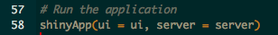
Two Basic Parts of the function
UI – User Interface
Builds the webpage
Can be done in R code OR HTML
Server
Generates all reactive content
Can be used to change portions of UI

Slide 10
The User Interface
UI

Slide 11
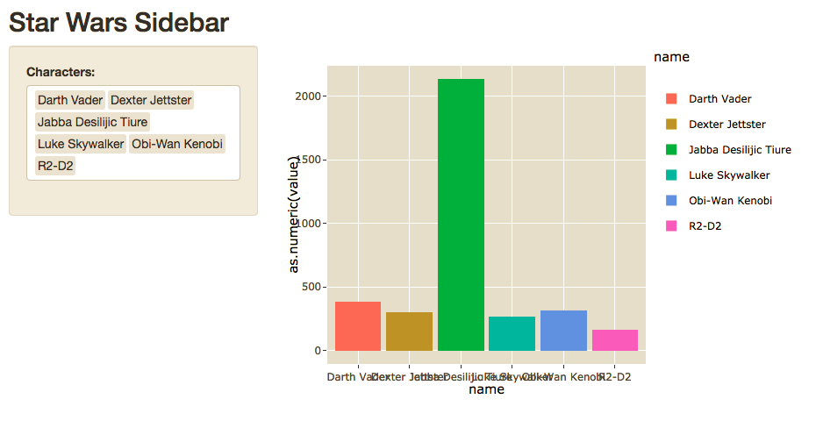
Sidebar Layout

Slide 12
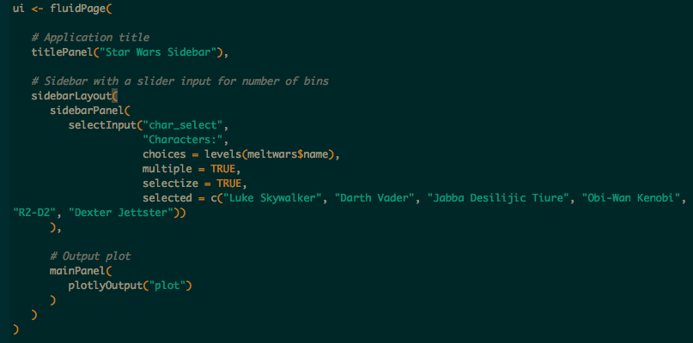

Slide 13
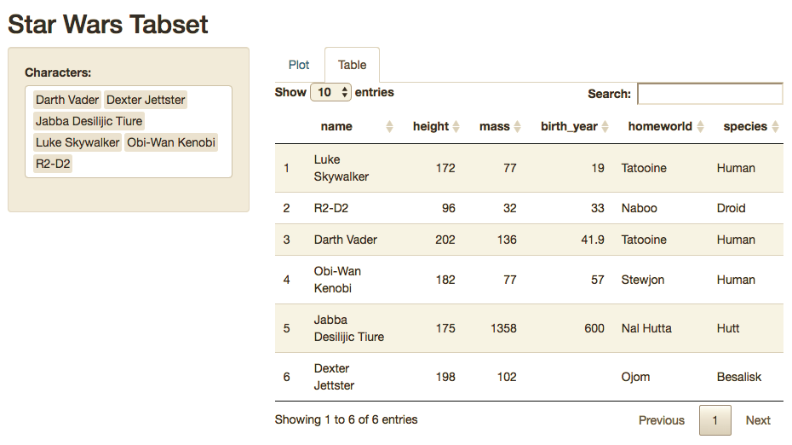
Sidebar w/ Tabset

Slide 14
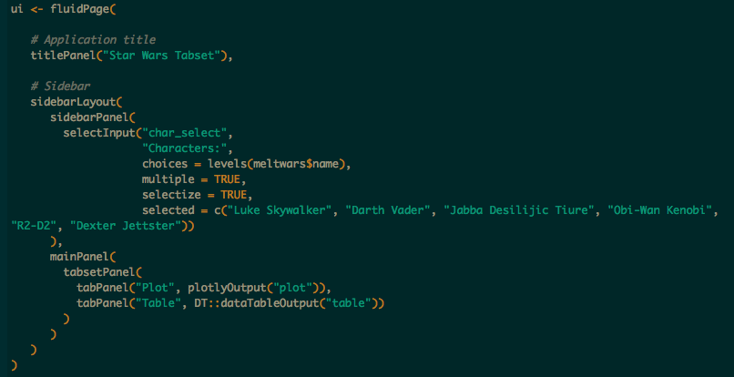

Slide 15
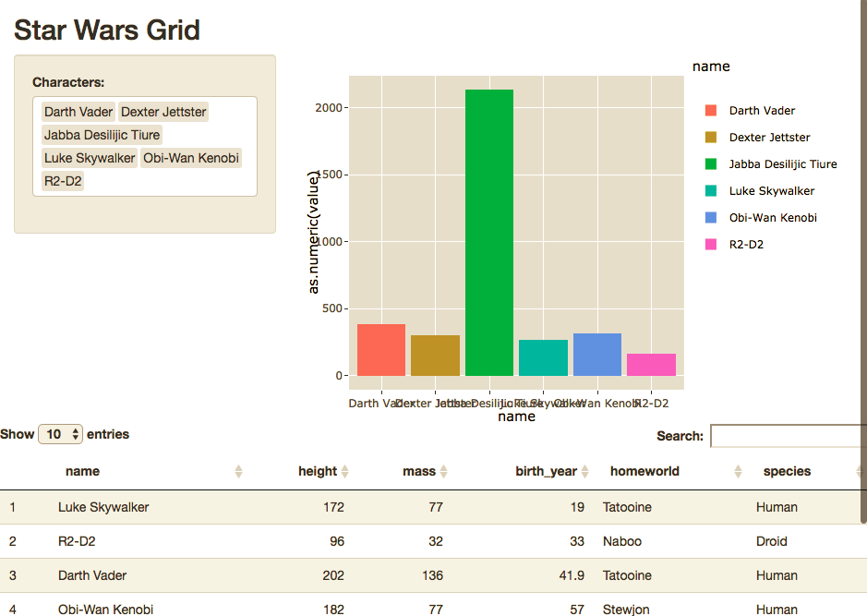
Grid

Slide 16
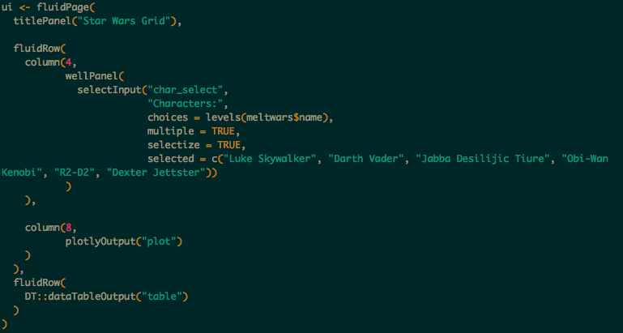

Slide 17
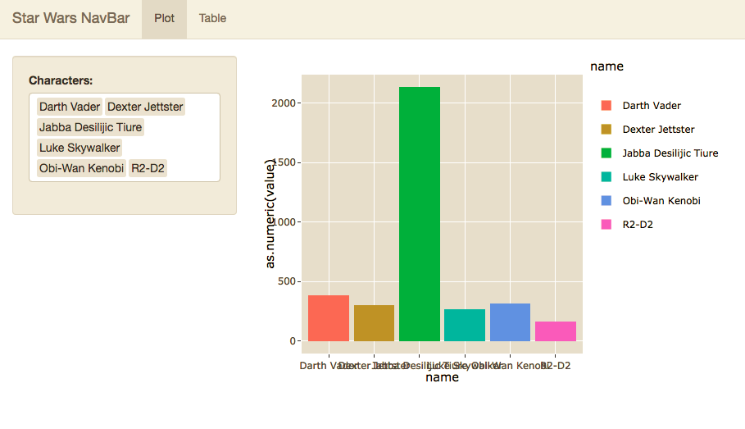
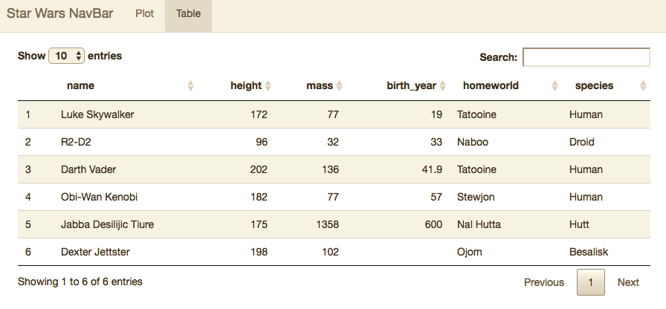
NavBar

Slide 18
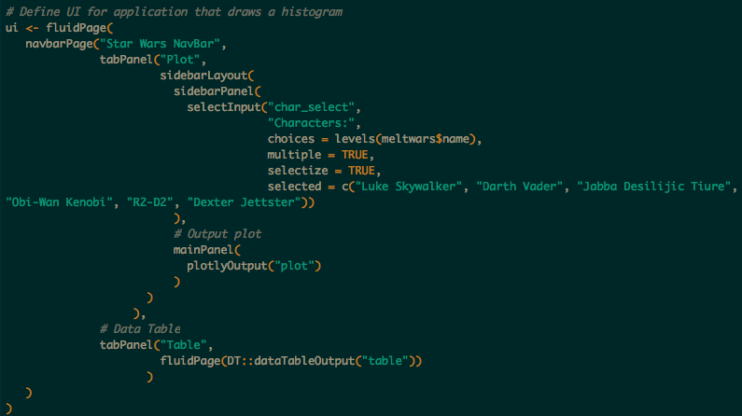

Slide 19
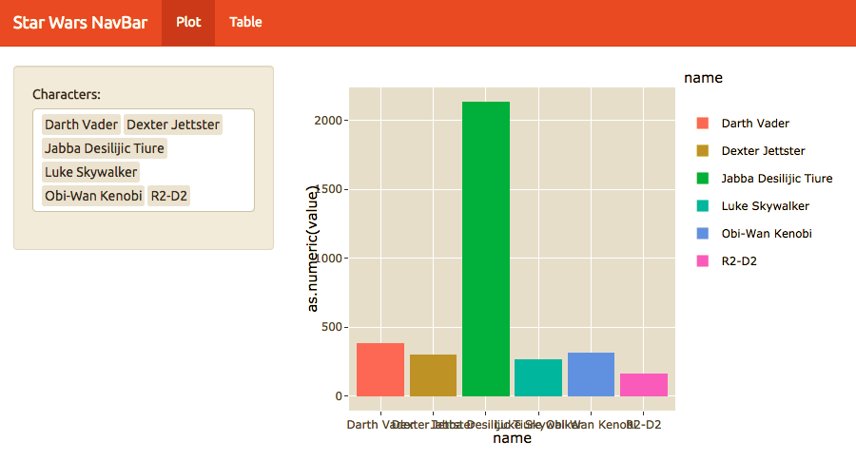
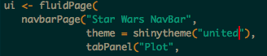
Custom Theme

Slide 20
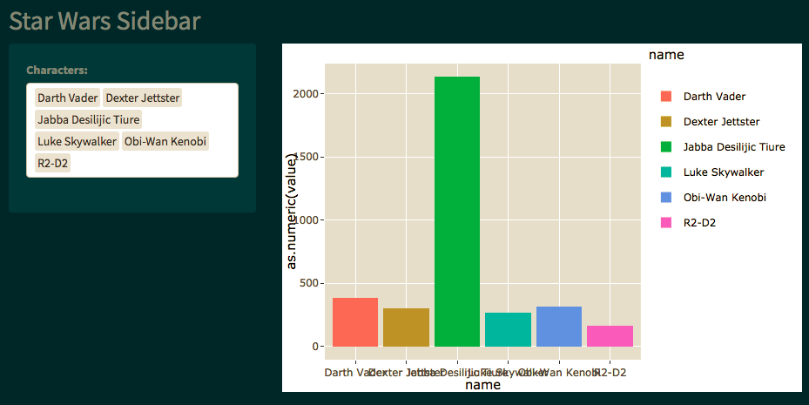
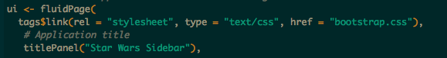
Custom Themes

Slide 21
The Server Function
server

Slide 22
Introduction to Server Function
Outputs
List of functions called in the UI which generates plots, tables and other objects.
Will regenerate whenever dependent inputs are changed, or based off of required action in UI.
Shiny Apps will display from any graphics package including;
ggplot2
plotly
DT
LeafletR
googleVis
wordcloud2
ggmap

Slide 23
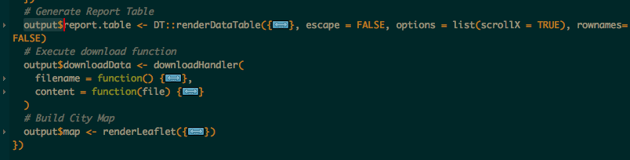
Saving Outputs
Output is a list which you build onto as you create your visuals
Each entry in the list is called in the UI by the name saved.
Example:
The three outputs below are called by “report.table”, “downloadData” and “map” respectively.
Otherwise these images work just like anything created in an RMarkdown document

Slide 24
Shiny Dashboards
Section 3

Slide 25
Basic Layout
Dashboards are broken into a single argument made up of three arguments
Header – Window title as well as Menus
Sidebar – Sidebar for navigating Dashboard tabs and can hold global selection inputs
Body – Where the magic happens.

Slide 26
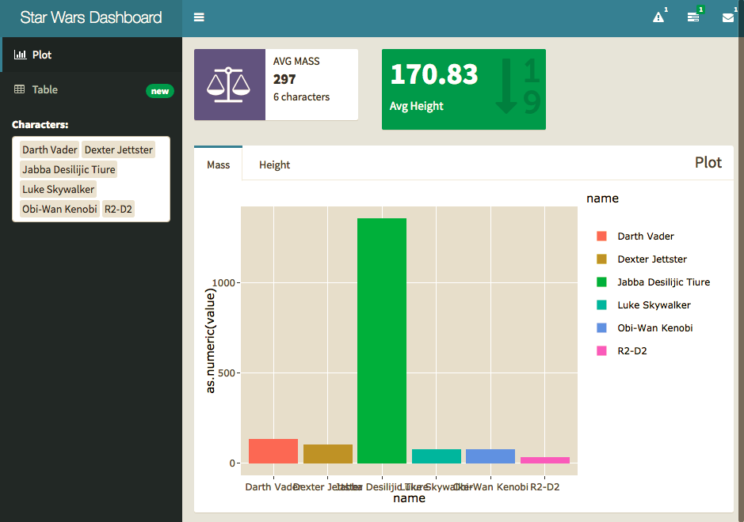

Slide 27
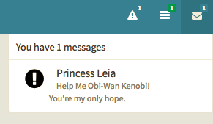
Headers

Slide 28
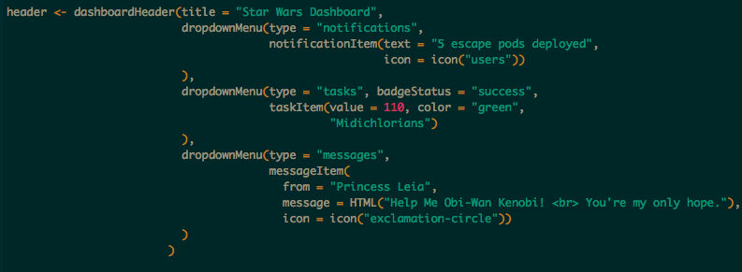
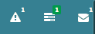
Options
Notifications
Tasks
Messages

Slide 29
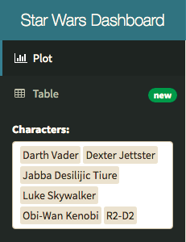
Sidebar

Slide 30
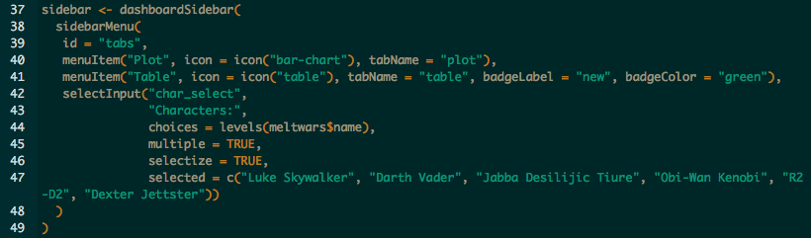
Menu Items – tabName referenced in body.
Global Inputs – Should work on all tabs and for all visuals.

Slide 31
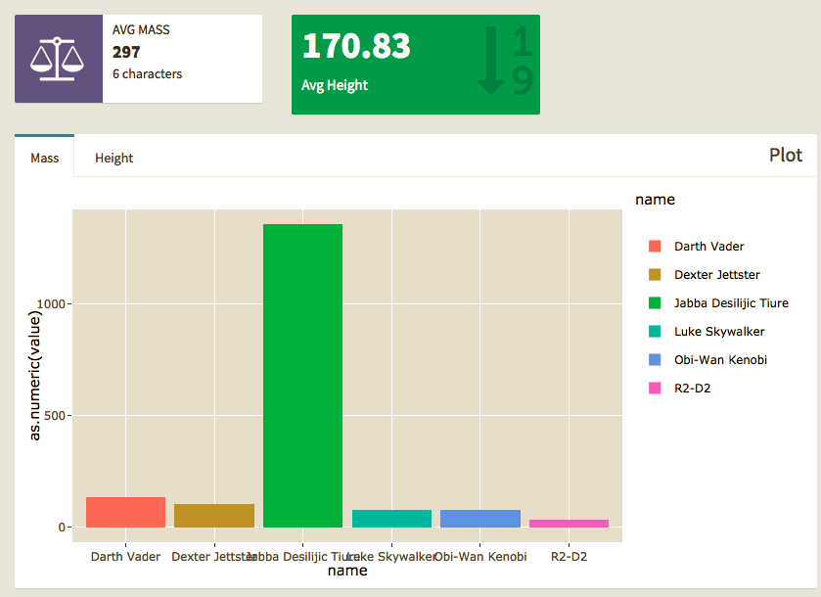
Body

Slide 32
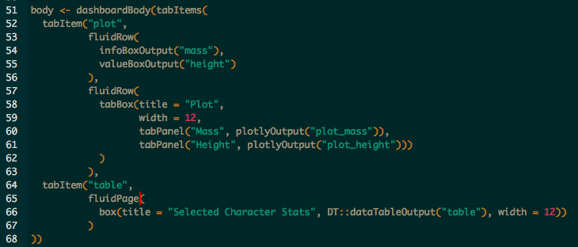
Tab Items – by name in Menu
Row\Page – based layouts
Box – All contents should go in a box
Page is broken into 12 equal bars. Width can be 1-12
If 12+ is specified content will kick to new row automatically, anything unspecified will get squished.
Inputs – can also go in boxes here should be clear what visuals they work with.

Slide 33
Widgets & Reactivity
https://shiny.rstudio.com/gallery/widget-gallery.html
Section 3

Slide 34
How do Input Widgets Work?
Inputs are sent to the server function as a list.
Each are called by input$“inputId”
Value and length of the input depends on the widget
Inputs can even be entire files, images, urls etc.

Slide 35
Numeric Inputs

Slide 36
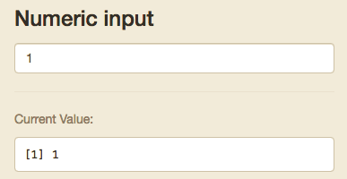
Numeric Input
Goes up and down based off clicks
Stored as single numeric input

Slide 37
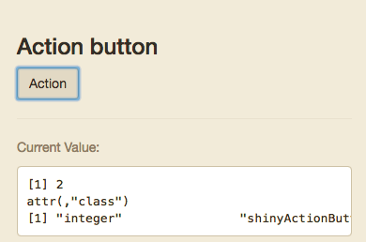
Action Button
+1 each time it is clicked
Stored as single numeric input

Slide 38
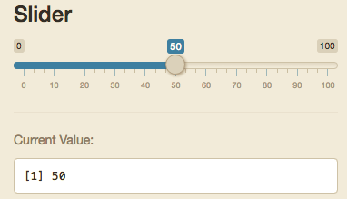
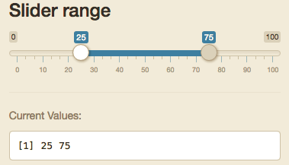
Slider/Range
Either a single integer or list of 2 called separately by input$“inputId”[1] and input$“inputId”[2]

Slide 39
Text Inputs

Slide 40
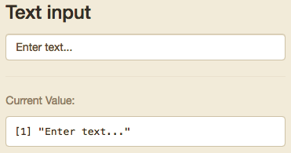
Text Input
Can be tied to action button or enter to initialize input.

Slide 41
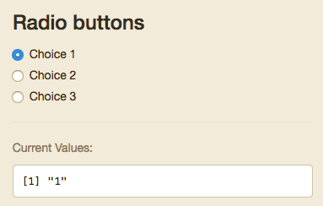
Radio Buttons
Only one option
Value can be dictated in your code, but will default to the value of the text in the choices field

Slide 42
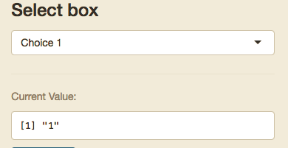
Select input
Can be set to only one selected option or multiple
Value can be dictated in your code, but will default to the value of the text in the choices field
Stored either as a single object or as a list

Slide 43
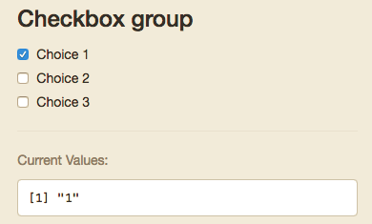
Checkbox Group
Multiple can be selected
Value can be dictated in your code, but will default to the value of the text in the choices field
Stored either as a single object or as a list

Slide 44
Other Inputs

Slide 45
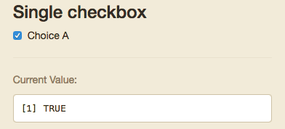
Single Checkbox
Boolean

Slide 46
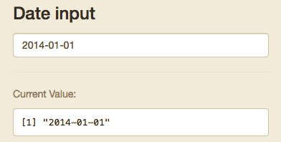
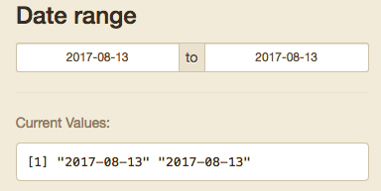
Date/Range
Either a single integer or list of 2 called separately by input$“inputId”[1] and input$“inputId”[2]
R will see these as Dates

Slide 47
Single Checkbox
Boolean

Slide 48
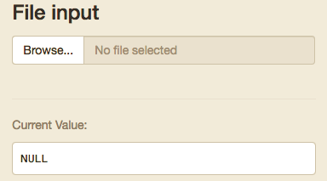
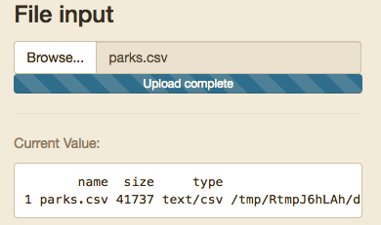
File Input
You should make sure your code checks the format and end of the file

Slide 49
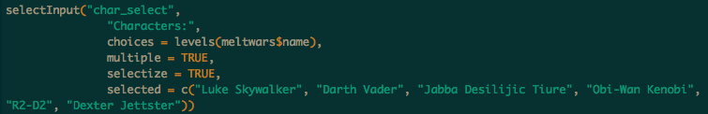
How are inputs stored?
Inputs are stored as a list of lists
For example:
Below the input is called using: input$char_select
Since multiple values can be selected, it has a length equal to the number of characters selected.
input$char_select[1] returns “Luke Skywalker”
Therefore A date range or two sided slide bar input is always a length 2

Slide 50
Output Based Inputs

Slide 51
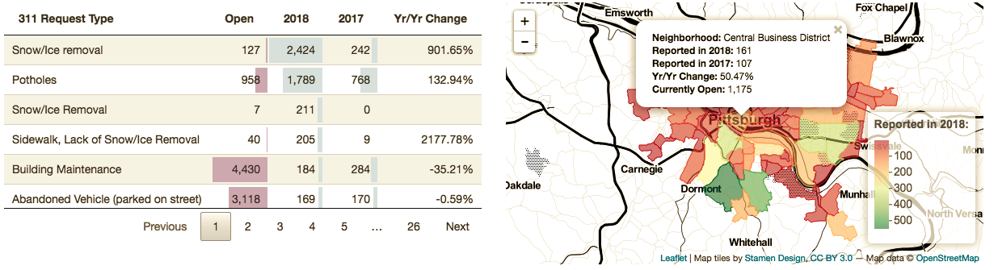
Data Table
The DT::datatable outputs has many inputs you can use to control other plots or outputs.
Before

Slide 52
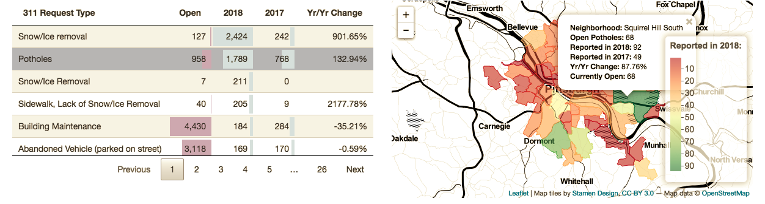
Data Table
The DT::datatable outputs has many inputs you can use to control other plots or outputs.
After

Slide 53
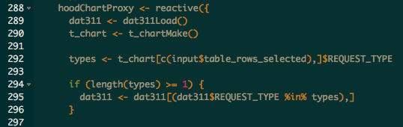
Data Table
The DT::datatable outputs has many inputs you can use to control other plots or outputs.

Slide 54
reactive

Slide 55
Everything in R is a Function
Reactive Datasets are a functions you can call whenever you need a set of actions to occur based off of filters in your application
They should be used whenever you are using the same inputs/filters on the same data for multiple outputs/visuals.
You can call reactive functions within other reactive functions for simple
These go in the server function/files
They are called as any function but with no arguments
Caches results to speed up loading
Ensures your visuals are all showing the same information
Shorter more legible code

Slide 56
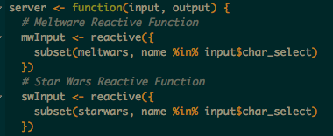
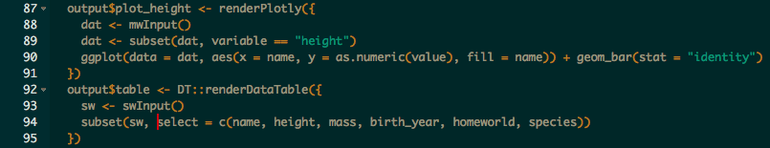
Reactive Example
Using our Shiny Dashboard from last week we have a bunch of plots and info boxes using the same data and filters.
If we add reactive functions we can call the filtered data automatically in each output.

Slide 57
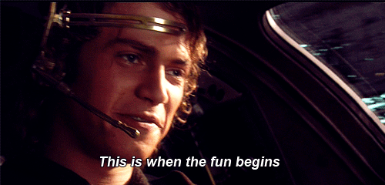
Practice

Slide 58
Update inputs and more
Section 4

Slide 59
Updates

Slide 60
Updates & Observe Events
Any time you wish to update part of your UI you will need to include an event observer.
Here you will be observing an input that your user can interact with
Observers can be done in one of two ways. Event observers or generic observer function
observeEvent() when you are observing a particular input
observe() works if you want to observe multiple things, or non-input based object such as the output or content of a reactive function.

Slide 61
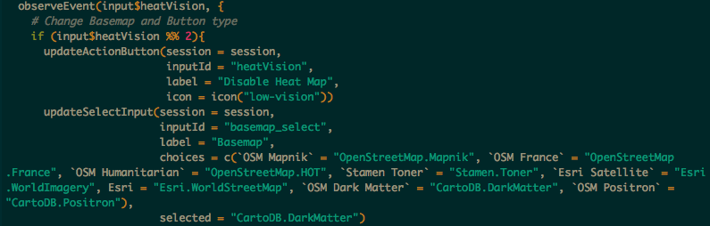
Event Observer Example
Here we will look at how I use this in the Burgh’s Eye View

Slide 62
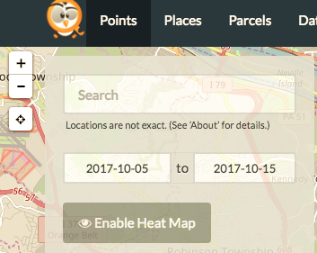
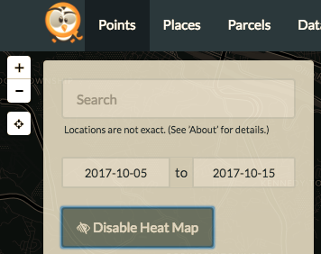
Before: After:

Slide 63
Notifications

Slide 64
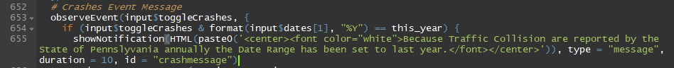
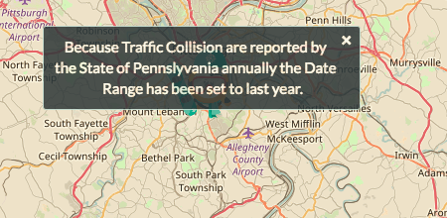
Notification Example

Slide 65
Bookmarking

Slide 66
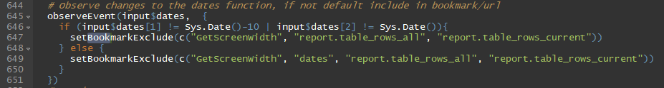
Bookmarking Example

Slide 67
Progress Bars

Slide 68

Progress Bar Example

Slide 69

Practice

Slide 70
Break

Slide 71
RMarkdown
Section 5

Slide 72
Flex Dashboard
All code is handled within the Markdown Style
You can embed standalone shiny apps, or use elements from the dashboard at large.
More structured than shiny apps, but…
It’s easier
Looks nicer

Slide 73

Setup
Other options
Logo
NavBar Icons
Embed Code
Sharing Links
Custom CSS file

Slide 74

Global Sidebar

Slide 75

Page Sidebar

Slide 76

Side Bar

Slide 77

Value Box

Slide 78

Plot

Slide 79


Slide 80

Data Table

Slide 81


Slide 82
Gauge

Slide 83

Gauge

Slide 84
Flexdashboard: Storyboard

Slide 85

Setup

Slide 86

Basic Board Page

Slide 87
Shiny Apps.io
http://www.shinyapps.io/
Section 6

Slide 88


Register a free Account

Slide 89


Connect your account

Slide 90

Publish todays app

Slide 91

Practice

Slide 92


